Slide 1


Capstone Project
Automatic Bone Fracture Detection and Classification from X-Ray Images Using Deep Learning with VGG16 and ResNet50
Team no. 6
MLA0405 – Deep Learning
Students Name
S.Mubarak(192425194)
D. Devisri Prasad(192425221)
D. Chinna Moulali(192425278)
N.Kameshwar Reddy(192525272)
N.Jeevan sai(192525169)
Guided By
Dr. A. M. Arul Raj
Professor
SIMATS Engineering
Notes:
1
1

Slide 2
Abstract
Develops an automated system for detecting and classifying bone fractures from X-ray images using Deep Learning.
Utilizes Transfer Learning with VGG16 and ResNet50 models to extract features and improve classification accuracy.
Performs data preprocessing, model training, and fracture classification on X-ray image datasets.
Evaluates and compares both models using performance metrics such as Accuracy, Precision, Recall, and F1-Score.
Provides fast and accurate fracture predictions to assist radiologists in improving diagnosis and clinical decision-making.

Slide 3
Aim and Objective
Aim
To develop an automated deep learning system for detecting and classifying bone fractures from X-ray images using VGG16 and ResNet50 transfer learning models, enabling accurate and efficient diagnosis.
Objectives
Collect and preprocess bone X-ray images to create a high-quality dataset for model training.
Extract meaningful image features using transfer learning with VGG16 and ResNet50.
Detect and classify bone fractures accurately using deep learning techniques.
Evaluate and compare the performance of both models using metrics such as Accuracy, Precision, Recall, and F1-Score.
Develop a prediction system that provides fast and reliable fracture detection results to assist healthcare professionals.

Slide 4
Introduction
Bone fractures are common injuries that require accurate and timely diagnosis for effective treatment.
X-ray imaging is the standard method used by doctors to identify bone fractures.
Manual analysis of X-ray images can be time-consuming and may result in diagnostic errors.
This project uses Deep Learning with VGG16 and ResNet50 transfer learning models to automatically detect and classify bone fractures.
The proposed system aims to improve diagnostic accuracy, reduce analysis time, and assist healthcare professionals in making faster clinical decisions.

Slide 5
Literature Review
S.No | Year of Publication | Author | Title of the Journal / Book | Methodology Used | Algorithm Used | Key Findings
1 | 2023 | Olczak et al. | Artificial Intelligence for Fracture Detection in Musculoskeletal Radiographs | Deep Learning-based Medical Image Analysis | CNN | AI-assisted diagnosis improved fracture detection accuracy and reduced diagnostic errors.
2 | 2022 | Li et al. | Bone Fracture Classification Using Transfer Learning | Transfer Learning on X-ray Images | VGG16 | VGG16 achieved high classification accuracy with reduced training time.
3 | 2022 | Cheng et al. | Automatic Bone Fracture Detection Using Deep Residual Networks | Feature Extraction and Image Classification | ResNet50 | ResNet50 provided better feature extraction and higher accuracy than conventional CNNs.
4 | 2021 | Kumar et al. | Deep Learning-Based Bone Fracture Detection from X-Ray Images | Image Preprocessing and CNN Classification | VGG16 & ResNet50 | Comparative analysis showed ResNet50 outperformed VGG16 in fracture detection.

Slide 6
Problem Statement
Manual X-ray analysis is time-consuming.
Fracture detection depends on radiologist expertise.
Small fractures may be missed during manual analysis.
Hospitals handle a large number of X-ray images.
Manual diagnosis may cause errors and delays.
An automated deep learning system is needed for fast and accurate fracture detection.

Slide 7
Existing System vs Proposed System
Existing System | Proposed System
Bone fractures are diagnosed manually by radiologists through visual inspection of X-ray images. | Bone fractures are detected and classified automatically using Deep Learning models (VGG16 and ResNet50).
Diagnosis is time-consuming and depends on the expertise of the radiologist. | Provides fast and consistent predictions with minimal human intervention.
Manual analysis may lead to diagnostic errors, especially for subtle fractures. | Transfer Learning improves feature extraction and enhances detection accuracy.
Traditional methods have limited capability to handle large volumes of X-ray images efficiently. | The system efficiently processes large datasets and supports real-time fracture detection.
No automated comparison of different deep learning models for optimal performance. | Compares the performance of VGG16 and ResNet50 using evaluation metrics to identify the best-performing model.

Slide 8
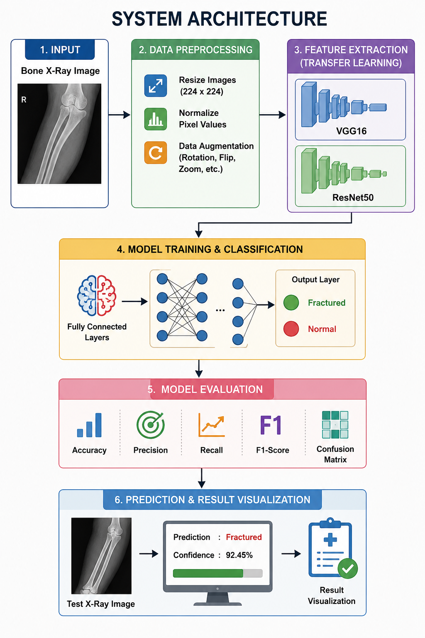
Overall System Architecture Design

Slide 9


Sustainable Development Goal (SDG) Implementation
SDG Goal | Implementation in the Project
SDG 3 – Good Health and Well-being | The proposed system assists doctors and radiologists in accurately detecting and classifying bone fractures, leading to faster diagnosis and improved patient care.
SDG 9 – Industry, Innovation and Infrastructure | Utilizes advanced Deep Learning techniques (VGG16 and ResNet50) to develop an innovative AI-based healthcare solution for medical image analysis.
SDG 10 – Reduced Inequalities | Supports healthcare facilities with limited access to experienced radiologists by providing automated fracture detection, improving access to quality healthcare.
SDG 17 – Partnerships for the Goals | Encourages collaboration between healthcare professionals, AI researchers, and technology developers to enhance medical diagnostic systems.

Slide 10
Proposed Methodology and Algorithm
Proposed Methodology
Collect and preprocess bone X-ray images.
Extract image features using VGG16 and ResNet50.
Train the models for fracture detection and classification.
Evaluate model performance using standard metrics.
Predict fractures from new X-ray images and display the results.
Algorithms Used
VGG16 – Extracts image features and classifies bone fractures.
ResNet50 – Deep residual network for accurate fracture detection.
Transfer Learning – Uses pre-trained models to improve accuracy and reduce training time.
Softmax Classifier – Predicts whether the X-ray is Fractured or Normal.

Slide 11
Module Planning
Module No. | Module Name | Description
Module 1 | Data Collection and Preprocessing | Collect bone X-ray images, preprocess them, and prepare the dataset for training.
Module 2 | Feature Extraction using VGG16 & ResNet50 | Extract important image features using transfer learning with VGG16 and ResNet50.
Module 3 | Bone Fracture Detection and Classification | Train the models to detect and classify bone fractures from X-ray images.
Module 4 | Model Evaluation and Performance Comparison | Evaluate and compare the performance of both models using accuracy and other metrics.
Module 5 | Prediction and Result Visualization | Predict fractures on new X-ray images and display the results with confidence scores.

Slide 12
Module 1 – Data Collection and Preprocessing
In this module, we first collect bone X-ray images from the dataset.
The images are divided into two main categories: Fractured and Normal.
Since the collected X-ray images may have different dimensions, all images are resized to 224 × 224 pixels.
Image normalization is performed so that the pixel values are in a suitable and consistent range for the deep learning models.
Data augmentation techniques such as rotation, flipping, and zooming are applied to create variations of the training images and improve model learning.
Finally, the prepared dataset is divided into training and testing datasets, which are used for model training and performance evaluation.

Slide 13
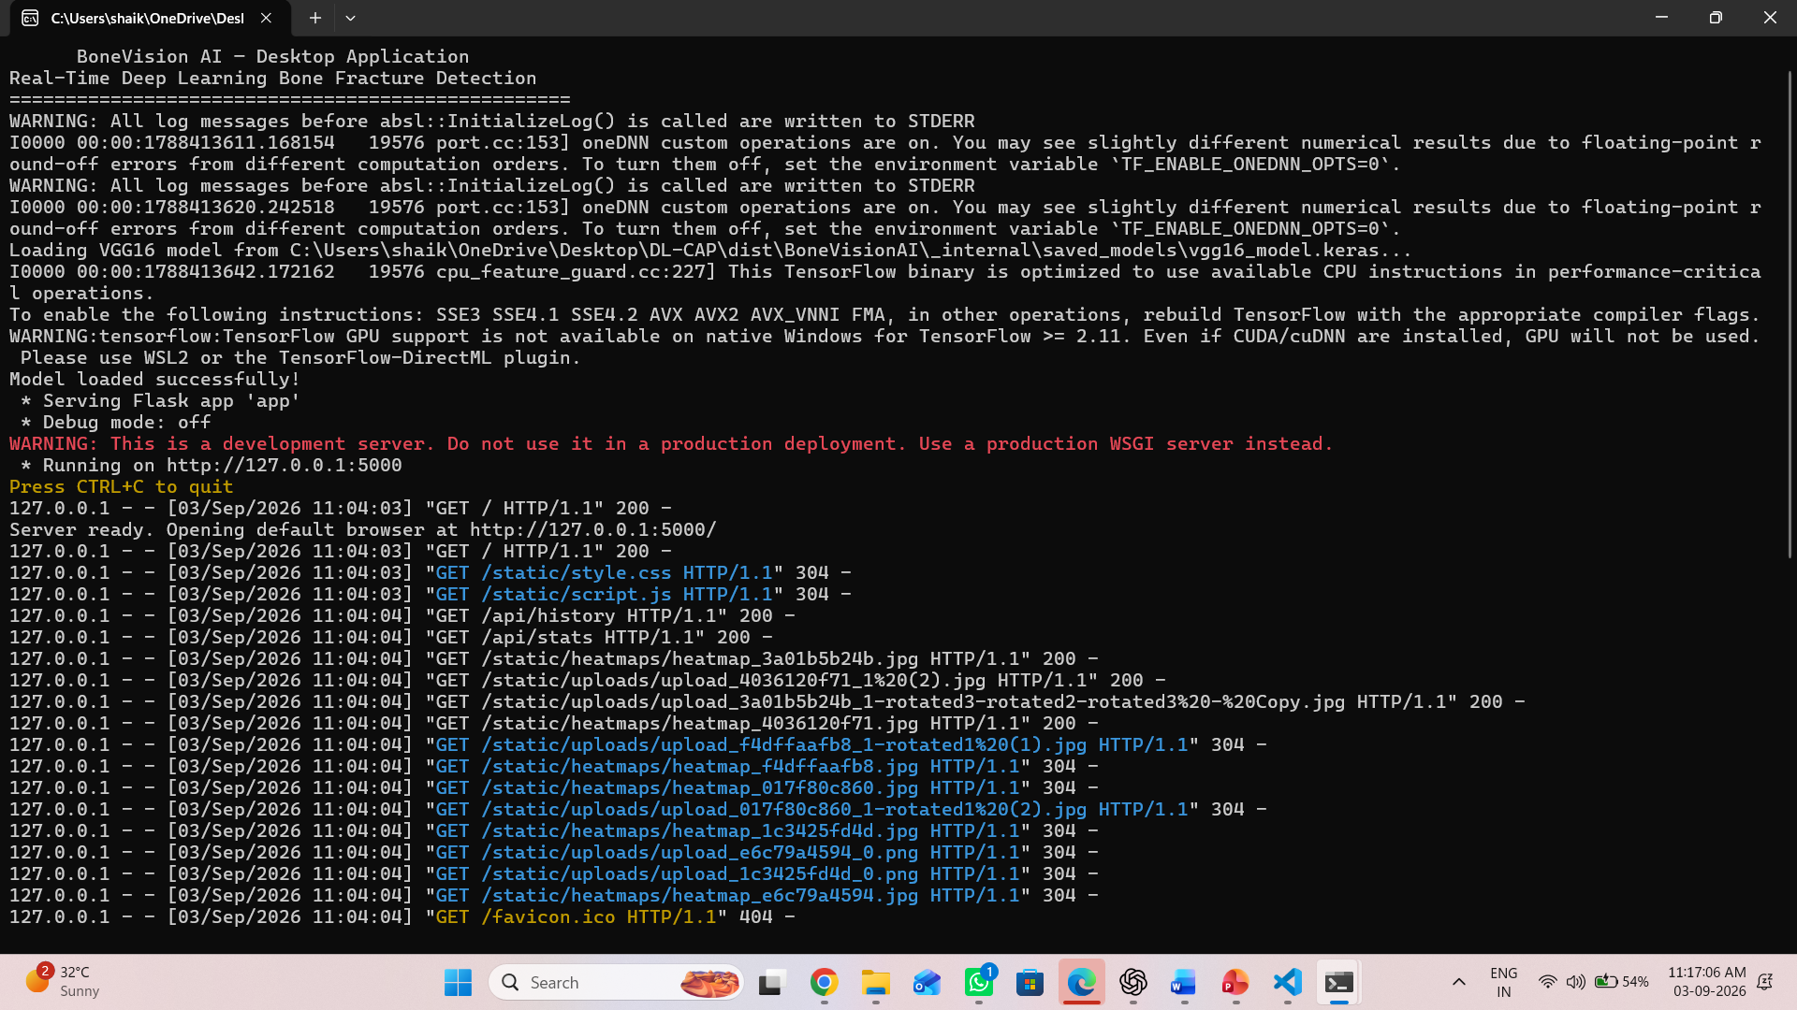
OUTPUT

Slide 14
Module 2 – Feature Extraction using VGG16 & ResNet50
In this module, we use two pre-trained deep learning models, VGG16 and ResNet50, for extracting important features from X-ray images.
These models use Transfer Learning, which means we use knowledge learned from large existing image datasets.
The preprocessed X-ray images are given as input to both VGG16 and ResNet50.
The convolutional layers automatically identify important image characteristics such as edges, shapes, textures, and patterns.
VGG16 extracts features using its sequential convolutional architecture, while ResNet50 uses residual connections for deeper feature learning.
The extracted features are then forwarded to the classification stage to determine whether the X-ray represents a fractured or normal bone

Slide 15
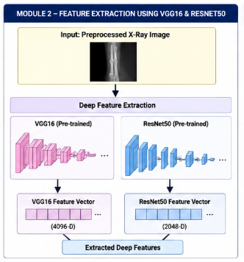
OUTPUT

Slide 16
Module 3 – Bone Fracture Detection and Classification
In this module, the features extracted from VGG16 and ResNet50 are used for fracture detection.
The models are trained using the prepared X-ray training dataset.
During training, the models learn the visual differences between fractured and normal bones.
When a new X-ray is provided, the trained model analyzes its extracted features.
A Softmax classifier is used to determine the final class based on the learned features.
The final classification result is displayed as either “Fractured” or “Normal.

Slide 17
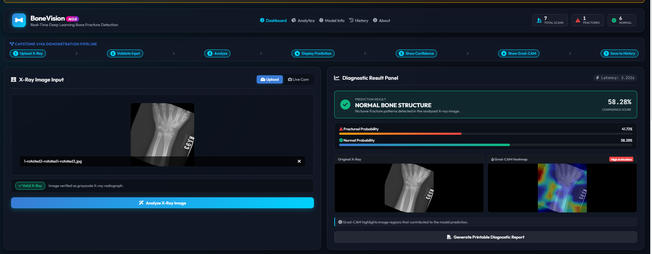
OUTPUT

Slide 18
Module 4 – Model Evaluation and Performance Comparison
After training the VGG16 and ResNet50 models, we test them using unseen X-ray images.
The purpose of this module is to check how accurately each model can detect bone fractures.
Accuracy is used to measure the overall percentage of correct predictions.
Precision measures how correctly the model identifies fracture predictions.
Recall and F1-Score are also used to understand the model's detection performance more effectively.
Finally, the performance of VGG16 and ResNet50 is compared to determine which model provides better fracture detection results

Slide 19
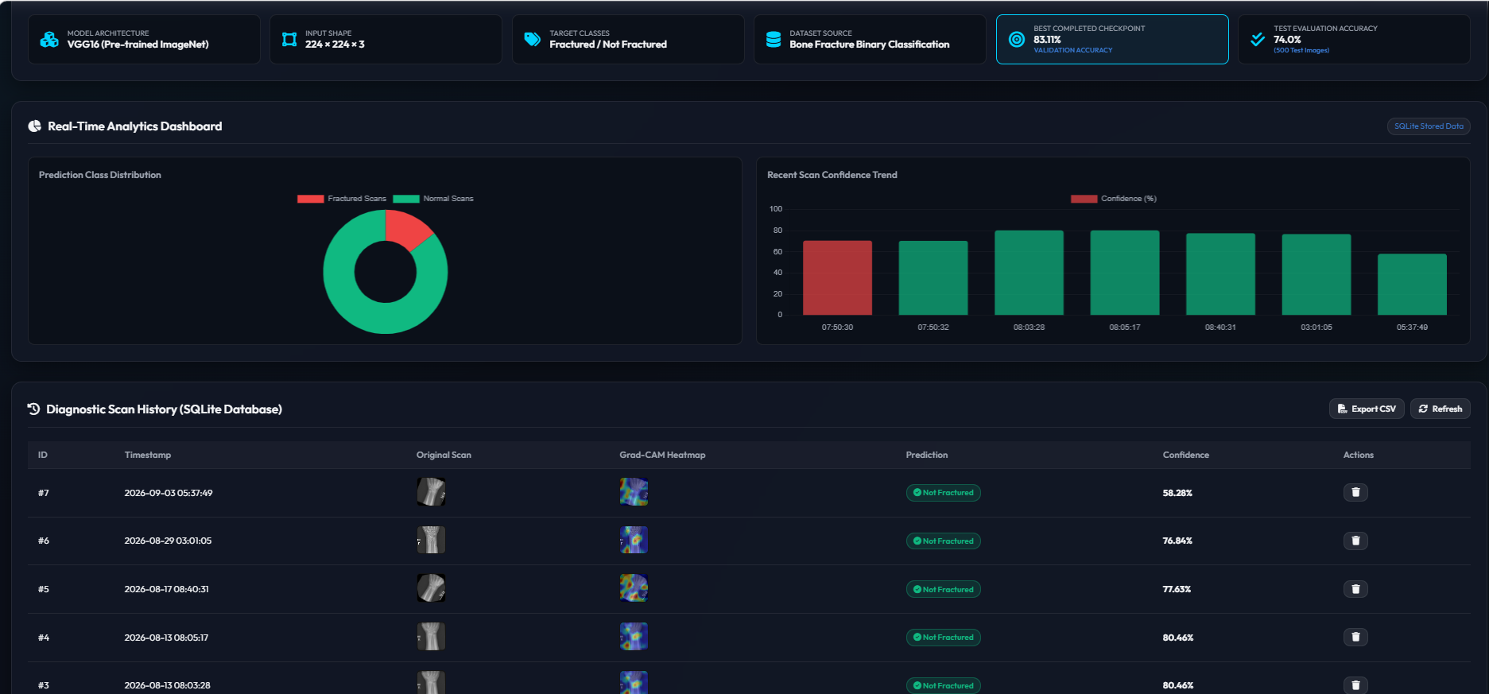
OUTPUT

Slide 20
Module 5 – Prediction and Result Visualization
In this final module, a new X-ray image is given to the trained deep learning model.
The new image is first preprocessed in the same way as the training images.
The trained VGG16 or ResNet50 model extracts the important features from the new X-ray.
The classifier uses these features to predict whether the bone is fractured or normal.
The system displays the prediction result along with a confidence score.
This provides a fast and consistent result that can assist radiologists and healthcare professionals in clinical decision-making

Slide 21
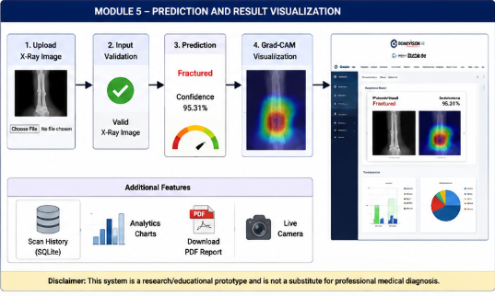
OUTPUT

Slide 22
Conclusion
The proposed system successfully automates bone fracture detection and classification from X-ray images using Deep Learning.
Transfer Learning with VGG16 and ResNet50 enables accurate and efficient feature extraction.
Performance comparison helps identify the model with better fracture detection accuracy.
The system reduces diagnosis time and assists radiologists in making faster and more reliable clinical decisions.
This AI-based solution has the potential to improve healthcare services and support future advancements in medical image analysis.

Slide 23
References
Simonyan, K., & Zisserman, A. (2015). Very Deep Convolutional Networks for Large-Scale Image Recognition. ICLR.
He, K., Zhang, X., Ren, S., & Sun, J. (2016). Deep Residual Learning for Image Recognition. IEEE Conference on Computer Vision and Pattern Recognition (CVPR).
Goodfellow, I., Bengio, Y., & Courville, A. (2016). Deep Learning. MIT Press.
Deng, J., et al. (2009). ImageNet: A Large-Scale Hierarchical Image Database. IEEE Conference on Computer Vision and Pattern Recognition.
Litjens, G., et al. (2017). A Survey on Deep Learning in Medical Image Analysis. Medical Image Analysis, 42, 60–88.
Olczak, J., et al. (2017). Artificial Intelligence for Analysis of Orthopedic Trauma Radiographs. Acta Orthopaedica.

Slide 24
Thank You!

